Slide 1
Module 4.2 / Week 8
Substantive tests of transactions and balances

Slide 2
Learning Objectives
  8.1 Identify and distinguish between tests of controls, substantive tests of transactions and substantive tests of balances.
  8.2 Identify and understand when the auditor will undertake substantive audit procedures in response to specific assessed risks of material misstatement.
Explain the specific audit objectives and the common substantive audit procedures traditionally used to address risks of material misstatement for:
          8.3 Cash, cash receipts and cash payments
          8.4 Sales, cash receipts and accounts receivable
          8.5 Purchases and inventories
          8.6 Accounts payable, payments and payroll
          8.7 Non current assets
8.8 Identify the different substantive test approaches that may be used for account balances included in the income statement.
8.9 Describe and understand the use of audit software techniques, including advanced data analytics,in substantive testing.

Slide 3
LO 8.1
Relationship between evidence-gathering procedures

Slide 4
Relationship between evidence-gathering procedures
        Auditor has to obtain sufficient appropriate evidence to support the auditor’s opinion (ASA 500/ISA 500).
        Tests of controls and substantive tests of transactions and balances are two of the main evidence-gathering audit procedures.
        Auditor selects the most efficient and effective combination of audit procedures that allows them to achieve audit objective.
        Assertions are used to help auditor assess risks of material misstatement, and to direct their audit procedures in responding to these risks.

Slide 5
Types of substantive tests
Substantive tests of transactions: auditor inspects the underlying documents associated with the flow of a transaction through the system.
Substantive tests of balances: auditor tests amounts resulting from a summation of a number of transactions.
Substantive analytical procedures: tests that determine the amount of misstatement in an account balance.
Substantive tests of transactions and substantive tests of balances together are called substantive tests of details.

Slide 6
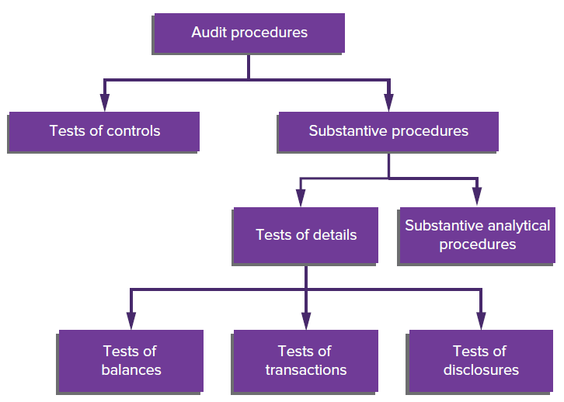
Types of audit procedures
Source: Grant, G. & Simnett, R. (2018). Auditing & Assurance Services In Australia (7th Ed), Sydney, Australia: McGraw Hill

Slide 7
Relationship between tests of controls and substantive tests of transactions
    Tests of controls: transactions selected to test whether related controls are working. Does not directly measure monetary error in accounting records.
    Substantive test of transactions: transactions selected to detect material misstatements in the financial report assertions.
    Dual-purpose tests are tests that address both control and substantive matters simultaneously
    Substantive tests of transactions focus on the individual transactions that make up the balance.
    Substantive tests of balances substantiate the ending balance of an account (which is comprised of multiple transactions).

Slide 8
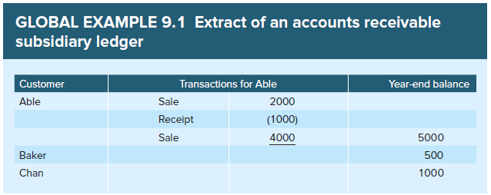
Distinguishing between substantive tests of transactions and substantive tests of balances
Source: Grant, G. & Simnett, R. (2018). Auditing & Assurance Services In Australia (7th Ed), Sydney, Australia: McGraw Hill

Slide 9
LO 8.2
Overall responses, financial report assertions and substantive audit procedures

Slide 10
Overall responses, financial report assertions
    Auditor must design and implement an appropriate audit response to address assessed risks of material misstatement at the overall (financial report) level.
    Appropriate responses to such risks of material misstatement may include:
          emphasising the need for the audit team to maintain professional scepticism
          assigning more experienced staff to the audit
          incorporating greater unpredictability into audit procedures
          making general changes to the nature, timing and extent of audit procedures, such as undertaking substantive procedures at period end rather than at an interim date
    The auditor develops specific audit procedures responsive to assessed risk of material misstatement for classes of transactions, account balances and disclosures.

Slide 11
Assertions about account balances at period end and audit procedures
Existence: the auditor selects from items contained in the accounting records and obtains evidence that supports them.
Rights and obligations: the auditor must ascertain that the assets and liabilities are owned/controlled by the client.
Completeness: the auditor identifies evidence indicating items that should be included in the account.
Accuracy, valuation and allocation: the auditor considers the appropriateness of the basis of accuracy and valuation of the asset or liability.
Classification: the auditor considers whether assets, liabilities and equity interests have been recorded in the proper accounts.
Presentation: the auditor considers the level of aggregation and the relevance and understandability of the related note disclosures.

Slide 12
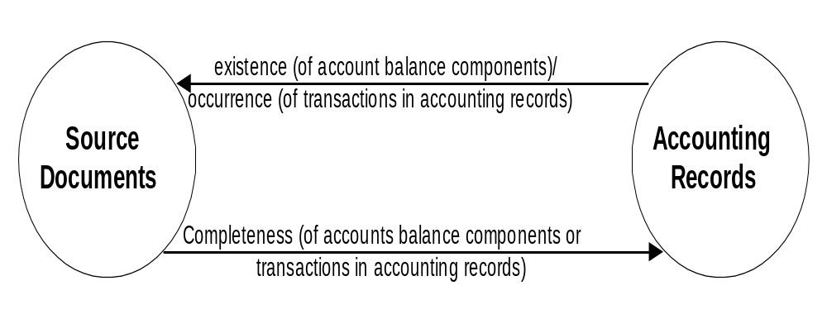
Existence/occurrence and completeness assertions
Note that the direction of testing determines whether the existence/occurrence or completeness assertion is tested. Existence will involve vouching to source documents, completeness will involve tracing to accounting records
Source: Grant, G. & Simnett, R. (2018). Auditing & Assurance Services In Australia (7th Ed), Sydney, Australia: McGraw Hill

Slide 13
Nature of the item and available evidence
    The nature of the item has an important influence on the auditor’s selection of audit procedures.
          For example, for the existence assertion, likely audit procedures are physical examination, external confirmation and vouching to source documents.
    An auditor can count cash on hand or sight equipment, but will confirm an accounts receivable balance.
    If an account balance is affected by only a few large transactions, the auditor may design substantive tests directed to the individual transactions in order to best substantiate the ending balance.

Slide 14
LO 8.3
Cash, cash receipts and
cash payments

Slide 15
Cash, cash receipts and cash payments
    The account balance ‘cash’ is directly affected by both the cash receipts and cash payments systems.
    The auditor would be most worried about the assertions of occurrence and completeness of transactions when undertaking substantive testing of these transactions systems.
    Accuracy of the dollar value is an assertion of concern if transactions involve foreign currencies.
    A major substantive tests of balances for the account ‘cash’ is substantiation of the client’s bank reconciliations for major assertions at risk, existence and completeness. Most of the direct tests of the cash balance make use of information obtained directly from banks.

Slide 16
Cash, cash receipts and cash payments: assertions of interest
These are primarily:
Cash | Cash receipts/payments
existence completeness, and possibly accuracy, valuation and allocation (if foreign currency balances) | occurrence completeness, and possibly accuracy (if foreign currency transactions)
since these are areas where misstatements are most likely to occur.

Slide 17
External confirmation of bank balances
    External confirmation procedures provide evidence that the cash in the statement of financial position exists at the balance date and that it is owned by the entity and is not restricted or committed.
    Audit guidance on bank confirmation procedures is provided by GS 016 Bank Confirmation Requests.
    The bank is required to confirm correctness of all details provided by the auditor, to list all other relevant information from details contained in its records and to ensure that all details supplied are as at the confirmation date.

Slide 18
Tests of a client’s bank reconciliation
    The essential objective of testing a client’s bank reconciliations is to substantiate that the balance confirmed with the bank agrees with the client’s cash accounting records.
    The extent of testing of the client’s reconciliations varies depending on the assessed level of control risk.
    When the level of control risk is assessed as:
        Low : substantive procedures might be confined to scanning the client reconciliations and comparing balances per bank to bank confirmations
        High: the auditor extends the substantive procedures in testing the client’s reconciliation by examining the individual details of reconciling items

Slide 19
LO 8.4
Sales, cash receipts and accounts receivable

Slide 20
Sales, cash receipts and accounts receivable
  Accounts receivable are significant current assets for many types of entities.
Assertions of interest:
Sales/cash receipts | Accounts receivable
occurrence accuracy cut-off | existence accuracy, valuation and allocation
    as these are areas in which misstatements are most likely to occur.

Slide 21
Common substantive procedures
                external (debtors’) confirmation
                subsequent receipts review
                cut-off
                substantive analytical procedures
                tests of sales transactions
                review of aged trial balance

Slide 22
External confirmation procedures
    Auditor may obtain confirmation from debtors using:
    Positive form —once debtor has been selected, auditor must obtain evidence and ask debtor to respond whether or not they agree with information as to amount owed in request. There will be follow-up procedures such as second request and checking invoices to shipping documents to prove sale for any non-response.
    Negative form —requests debtor to respond when they disagree with amount shown.
    Alternative procedures to debtors confirmations include examining evidence of subsequent cash receipts and examining sales and shipping documents.

Slide 23
Confirmation procedure versus subsequent cash receipts testing
Confirmation | Subsequent cash receipts testing
existence YES accuracy, valuation and allocation NO | existence YES accuracy, valuation and allocation YES*
Subsequent cash receipts testing is commonly viewed as a superior form of evidence compared with confirmation procedures because it achieves both key assertions.
Confirmation still requires further tests of likelihood of payment (doubtful debts provision), which is part of accuracy, valuation and allocation. (* for those identified as subsequently paying.)

Slide 24
LO 8.5
Purchases and Inventory

Slide 25
Purchases and inventory
    Inventory consists of goods to be sold or used in the production of saleable goods.
    Major transactions involving inventory: increase to inventory when goods purchased and decrease to inventory when goods sold.
    Inventory generally receives considerable audit attention because it:
                is significant in the determination of income
                involves a high volume of activity
                involves accounting complexities
                Is susceptible to manipulation

Slide 26
Differences from the sales and expenditures cycles
    Nature and frequency of reconciliations: bank (monthly) versus inventory (yearly).
    Differences in importance of accounting principles.
    Materiality and method of allocation:
          For sales cycle, audit problems tend to be related to high volume clerical processing rather than complex accounting principles.
          For inventory cycle, audit problems arise from both high volume processes and complex accounting principles:
                assignment of costs to inventory by inventory flow assumptions
                identification of obsolete or slow-moving items
                lower of cost or net realisable value.

Slide 27
Inventory assertions, objectives and procedures
Assertions of interest for inventory are primarily:
Inventory | Purchases/payments
existence accuracy, valuation and allocation | occurrence accuracy cut-off

Slide 28
Inventory: Major Procedures
These are primarily:
    observation of physical inventory
    substantive analytical procedures
    cut-off testing around balance date to test that sales and purchases recorded in correct period
    tests of accuracy, valuation and allocation.

Slide 29
Observation of physical inventory
    The following list highlights key points about observation of physical inventory (some that are often misunderstood):
          The client’s taking of the physical inventory is a control activity.
          The auditor uses a combination of observation, enquiry and physical examination.
          The auditor’s goal is to obtain reasonable assurance that the client’s methods of counting inventory results in an accurate count, which is therefore a test of controls.
          In most circumstances there are no satisfactory alternative procedures to making or observing some counts of items in inventory for verifying the ending inventory.

Slide 30
Tests of accuracy, valuation and allocation
    Auditor is required to evaluate the bases used by management in the accuracy, valuation and allocation of inventory, and to perform audit procedures designed to obtain sufficient appropriate audit evidence regarding these bases.
    Audit sampling may be used in verifying cost of inventory by selecting purchases and vouching cost price back to suppliers’ invoices or cost accounting records.
    The auditor also needs to ensure that the inventory flow assumption used to assign costs to inventory are in accordance with an acceptable accounting method.
    With inventory required to be valued at lower of cost and net realisable value, auditor needs to test for obsolete, slow-moving or excess items.

Slide 31
LO 8.6
Accounts payable, payments and payroll

Slide 32
Accounts payable
    Accounts payable consists of trade and other creditors.
    A primary assertion of concern is completeness as the most likely form of misstatement is understatement.
    A search for unrecorded liabilities and analytical tests performed on related expense account balances are common procedures for completeness.
    External confirmation procedures can also address this assertion, if confirmations are sent to all major suppliers irrespective of closing balance.

Slide 33
Search for unrecorded liabilities
    This procedure is also sometimes called ‘out-of-period liability search’ or ‘review of subsequent payments’.
    Errors result because invariably some goods or services received before period end do not become known and recorded until the next period.
    Auditor selects from cash payments recorded in the subsequent period and traces them to schedule of accounts payable outstanding at balance date, identifying payments that pertain to the period under audit.
    Auditor also reviews and selects from unmatched inventory receiving reports and suppliers’ invoices received by balance date and suppliers’ invoices recorded in subsequent period.

Slide 34
Payroll
    A common audit approach for payroll expenses and associated end-of-year accounts is to undertake a high level of tests of controls and substantive analytical procedures.
    The test of controls for payroll were previously discussed in chapter eight.
            Effective substantive analytical procedures are often possible for many payroll systems, due to the fact that periodic payrolls can be compared and analysed for fluctuations indicating risks of material misstatement.
    If auditor finds that they cannot rely on the key controls in order to reduce risk of material misstatement to an acceptable level, they will need to undertake more detailed substantive testing.

Slide 35
LO 8.7
Non-current assets

Slide 36
Property, plant and equipment
    The balances of non-current asset accounts are usually affected by a few relatively large transactions each year----it is usually efficient for auditors to verify account balances by performing tests on individual transactions.
    Assertions of interest are generally:
                existence
                rights and obligations
                accuracy, valuation and allocation.

Slide 37
Property, plant and equipment: key procedures
    Vouching: inspecting the supporting documentation for additions, retirements and changes in valuation or allocation methods during the period.
    Physical examination
    Substantive analytical procedures
    Recalculating related expense accounts such as depreciation

Slide 38
Use of experts
    ASA/ISA 540.A96–A101 provides guidance for the consideration of whether specialised skills or knowledge are required.
    If the valuation is undertaken by an independent expert, the auditor needs to be satisfied as to their skill, competence and objectivity.
    The auditor vouches the valuer’s report, paying regard to the basis of valuation, and considers its appropriateness as a basis for determining the carrying amount of that class of assets in the financial report.

Slide 39
Income Statement
    In a double-entry accounting system, testing one side of a transaction automatically tests the other side.
    A procedure that achieves an audit objective for one side of a transaction should achieve a comparable audit objective for the other side.
    For example, if the auditor verifies the existence of an accounts receivable balance, this will verify the occurrence of the related income statement sales transactions.
    For this reason the extent of substantive tests of transactions is inversely related to the amount of substantive testing of balances that is undertaken.

Slide 40
Audit procedures for Income Statement accounts
    Substantiation by simultaneous tests of accounts, e.g. sales → accounts receivable.
    Substantiation directly in conjunction with statement of financial position accounts, e.g. plant and equipment → depreciation.
    Substantiation directly by substantive analytical procedures, e.g. relationships following a predictable pattern such as sales → sales commission.
    Substantiation directly by separate tests of individually significant transactions, events or account balances, e.g. discontinued operations

Slide 41
LO 8.9
Using audit software, including data analytics, to aid the undertaking of substantive tests

Slide 42
Traditional approach versus advanced data analytics
    Using a traditional audit approach, audit software can be used with master files or transaction files, so the audit procedures may be tests of details of transactions (if testing transactions files) or balances (if testing master files).
    However, these traditional views of audit software are currently being challenged by some of the more advanced data analytics
    Advanced data analytics for substantive procedures involves analysing complete files, and discovering and analysing patterns, deviations and inconsistencies in the data.

Slide 43
Generalised audit software (GAS)
    When generalised software is run, the first step is to read the client’s file.
    To run generalised audit software it is necessary to:
          specify file format
                client file formats vary considerably
                defined by the auditor as part of the input specification
            processing instructions
                generalised audit software is designed to perform several types of processing tasks.
                auditor can select tasks that they want from menu, such as add, sort, merge, identify large amounts.

Slide 44
Functions of audit software
    Audit software can interrogate clients’ files in order to:
            select sample items
            identify records meeting specified criteria (exception reporting)
            test and make calculations
            compare data in separate fields or in separate files
            summarise data
            generate reports.

Slide 45
References
Grant, G. & Simnett, R. (2017). Auditing & Assurance Services In Australia (rev: 6th Ed), Sydney, Australia: McGraw Hill
Moroney, R., Campbell, F., & Hamilton, J., (2017). Auditing: A Practical Approach, (3rd ed), Sydney, Australia: Wiley

